Slide 1
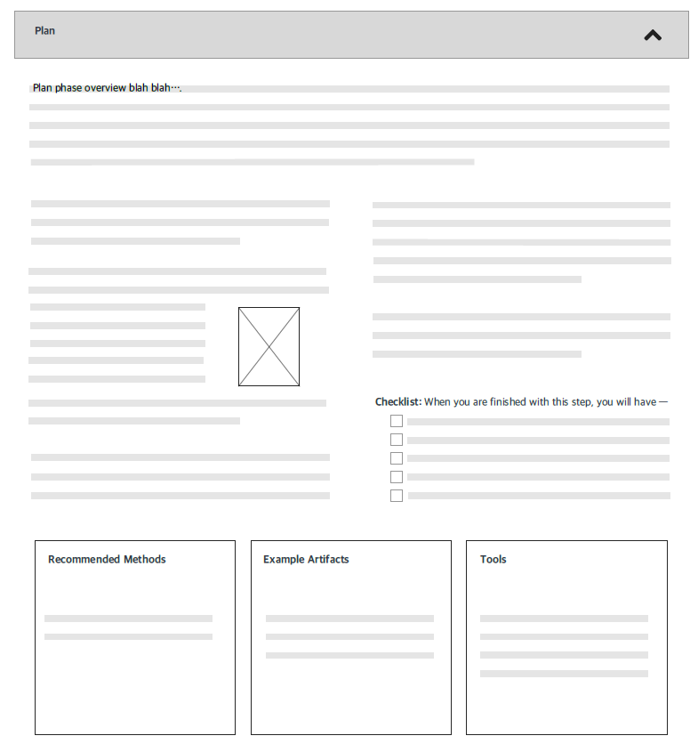
Naomi, let’s not have an intro to a phase. Just erase that paragraph. And on Evaluate.
The plan phase for this playbook begins when you receive a work order that will require a clinical reminder. During the plan phase, you will perform activities that will define the user needs, relevant context, the stakeholders for this work, and those who will be involved in the reminder design.
The first step is to identify your stakeholders. Stakeholders may include the work requestor, other people who will use the reminder and / or the reports that will be generated from it. Sometimes management will need to be included to determine if there are impacts to other areas that need to be identified.
Next, schedule and conduct a kick off meeting, and develop a problem statement. These activities are probably familiar to you, the information here is meant to provide you with some best practices and tools to support your work.
The kick off meeting is a good time to:
Clarify the work request – document details.
Gain stakeholder agreement to the clarified work request – write a problem statement.
Establish a timeline to set expectations.
Inform stakeholders of their responsibilities, and when their input is needed.
Identify additional inputs that are required.
It is important after the kick-off meeting to communicate the decisions and agreements in writing to all involved.
If some stakeholders are not available for a group meeting, you can use the same materials and meet with them individually. This is not the best way, because in the group setting the most important activity is that everyone agrees on the task, the timing and the responsibilities. In the sections below, there are links to methods for these activities. There are also some examples, where the work has already been completed, and there are tools such as an agenda for a kick-off meeting. Use these to move through the plan phase. The problem statement will be important throughout this process.
Identified stakeholders
Conducted a kick-off meeting
Have an agreed on problem statement and timeline.
Problem Statement
Sample Problem Statement
Sample Kick off meeting agenda
Sample timeline
Agenda Template
Timeline Template
Problem statement Template
Naomi, we don’t have these or I do not know if we do, but just format them so that they appear to be links.

Slide 2
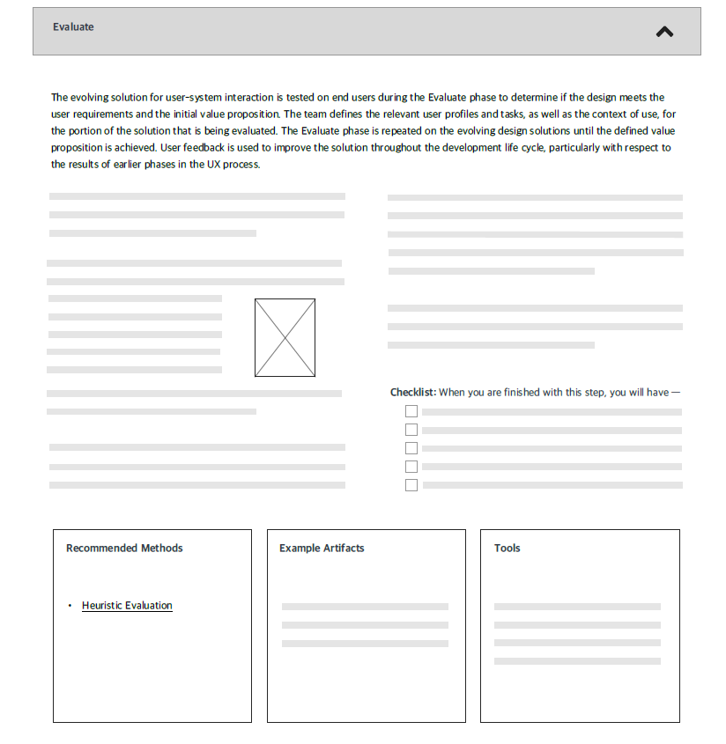
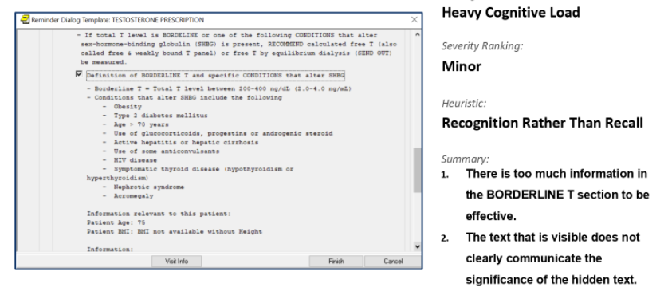
Evaluate phase is done for several reasons:
Check the work against the original set of requirements, developed during prior phases.
Check the work to see if it meets best practices for clinical reminders.
Evaluate is considered to be part of the process where work is developed, evaluated, updated based on the evaluation and evaluated again. This is the iterative process.
Evaluate the work against the requirements and problem statement to make sure that the reminder will meet your user’s needs.
This may require performing some testing, evaluation of the intended results.
Then, evaluate the reminder against a set of rules or guidelines to identify usability concerns. This is called performing a Heuristic Evaluation. There are a number of sets of heuristics that people have developed.
Remove this intro paragraph
At VAMC, a specific set of rules or guidelines is used called EHR 14. The clinical reminder is checked against this list, to make sure that these guidelines are addressed.
Verified that the reminder produces the intended data for reporting.
Evaluated each screen to identify usability concerns and issues.
Updated the reminder and moved it back into the Produce phase to address issues.
Generated a report for the stakeholders documenting these activities.
Sample data and test protocols
Heuristic Reports
Heuristic Checklist

